Slide 1
Diabetes Mellitus
What is Diabetes?
Presented by:
Katie Spear MSN, RN, CDCES

Slide 2
3 Takeaway Points
1. How the pancreas is the problem in diabetes.
2. How high blood glucoses or blood sugar effects your body.
3. The main two types of diabetes.

Slide 3
What is diabetes mellitus?
Diabetes is basically high sugar in the blood that is not able to be used effectively.
Your body needs to have sugar to help every part of your body work.
You eat food, which turns into sugar, and is then used for fuel and energy.
High blood sugars result from a pancreas that quits working.
The pancreas secretes insulin to help sugar to be used by the body for energy.
Insulin is the key that opens the door for sugar to get into the cells to be sued.
When blood sugar builds up, it becomes very thick and sticky, like Karo Syrup.
It is very difficult for this thick blood to move through your blood vessels, especially the small ones, like the ones that are in your eyes, kidneys and heart. So, high blood sugar effects every organ, including your brain, heart, kidneys, eyes, and your feet.
This is why it is so important to keep it under control.

Slide 4
Insulin:
Insulin is a hormone that is needed to assist blood glucose into the cells of your body for fuel and energy.
It is steadily produced in a healthy body.
It is like a key that opens the cells to let the glucose in to be used.

Slide 5
What Is Diabetes?
Type 1 Diabetes
Type 2 Diabetes
The body quits making insulin.
Insulin is necessary to help sugar get into the body’s cells so it can be used for energy or stored for later use.
Insulin needs to be replaced, The body cannot live without it.
Insulin injections are given by a shot, or by a continuous pump.
The body does make insulin, but it may not make enough to be used adequately.
or, the cells in the body may become insulin-resistant (not able to utilize the insulin). (Like using a key that does not fit).
Lifestyle changes, such as walking, or some type of activity, weight loss, and healthy eating may help to get blood glucose under control. If not, medication is needed.

Slide 6
Causes of Diabetes
Type 1 Diabetes
Type 2 Diabetes
Scientists aren’t sure what causes type 1 diabetes. It is not contagious and it is not caused by eating sugar. Research is under way to find the exact causes of type 1 diabetes and how it might be prevented.
Autoimmune- the body attacks itself, specifically the beta cells of the pancreas, which secretes insulin. Eventually the beta cells totally quit secreting insulin. The body has to have insulin to break down glucose. You need glucose for energy and to keep your body going. So, insulin needs to be replaced.
Risk Factors:
Being overweight
Family history of diabetes
Having gestational diabetes during pregnancy.
Having a baby who weighed more than 9 pounds.
High Blood Pressure
Being African American, Hispanic or Native American
Being more than 40 years of age.
History of Pre-diabetes

Slide 7
How do you know you have Diabetes?
It can vary from no symptoms to many symptoms.
Here is a list of the more common signs of diabetes?
Feeling tired.
Dry itchy skin.
Frequent passing of urine.
Frequent infections.
Increased thirst.
Possible weight loss.
Slow healing wounds.
Feeling very hungry.
Sexual dysfunction.
Blurry eyesight.

Slide 8
Overview of Diabetes Mellitus Symptoms
Type 1 Diabetes
Type 2 Diabetes
Classic symptoms
Frequent urination (Polyuria)
Excessive thirst (Polydipsia)
Excessive hunger (Polyphagia)
Weight loss
Weakness
Fatigue
Nonspecific symptoms
Classic symptoms of type 1 may manifest
Fatigue
Recurrent infection
Recurrent yeast or candidal infections
Prolonged wound healing
Visual changes

Slide 9
What treatments are used for Type 1 Diabetes
The two goals of diabetes treatment are to make sure you feel well day-to-day and to prevent or delay long-term health problems.
The best way to reach those goals is by:
Monitoring your blood glucose levels
taking insulin
planning your meals—
choosing what, how much, and when to eat
being physically active.
Tight glucose control.

Slide 10
What treatments are used for Type 2 Diabetes
The two goals of diabetes treatment are to make sure you feel well day-to-day and to prevent or delay long-term health problems. The best way to reach those goals is by:
Monitoring your blood glucose levels.
taking medications, if your doctor prescribes them
planning your meals—choosing what, how much, and when to eat
being physically active.
Tight glucose control.

Slide 11
Diagnostic Criteria for Diabetes
Any of these methods can diagnose diabetes:
Fasting Plasma Glucose (FPG) of 126 mg/dl or higher confirmed by repeat testing
Casual plasma glucose - more than 200mg/dl with s/s of diabetes (3 Ps with wt loss)
A 2 hr plasma glucose - more than 200mg/dl on aN Oral Glucose Tolerance Test
Hemoglobin A1C of 6.5% or higher (reflects last 2 to 3 months of average glucose) can be translated to eAG (estimated average glucose)

Slide 12
A1C
The A1C is a blood test that tells you what your average blood glucose levels have been for the past 2 to 3 months.
It measures how much glucose is attached to your red blood cells.
Because you are always making new red blood cells to replace old ones, your A1C changes over time as your blood glucose levels change.
The ADA’s target for A1C for most adults is less than 7%. Your doctor may recommend a higher or lower target depending on how old you are and other factors.
A1C | Average Blood Glucose
6% | 126 mg/dL
6.5% | 140 mg/dL
7% | 154 mg/dL
7.5% | 169 mg/dL
8% | 183 mg/dL
8.5% | 197 mg/dL
9% | 212 mg/dL
9.5% | 226 mg/dL
10% | 240 mg/dL
10.5% | 255 mg/dL

Slide 13
Summary for Overview of Diabetes Mellitus
Type 1 Diabetes
Type 2 Diabetes
Goal:
Tight Glucose Control
Treatment:
Insulin
Dietary Management
Exercise
Goal:
Tight Glucose Control
Treatment:
Lifestyle changes
Dietary management
Exercise
Weight Control
Medications as needed

Slide 14
Prediabetes
Prediabetes is when the blood sugar is higher than normal, but not quite as high as Diabetes.
Blood sugar of 100-126 mg/dL.
A1C of 5.7-6.4 %
Random Blood sugar of 200mg/dL or greater.
If not kept under control, it may lead to Type 2 Diabetes.

Slide 15
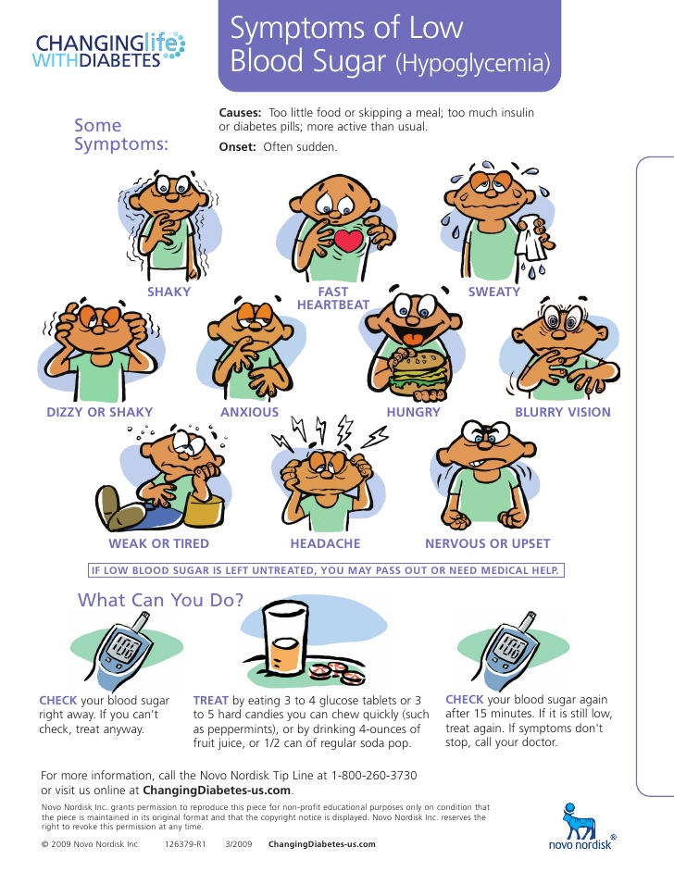

Slide 16
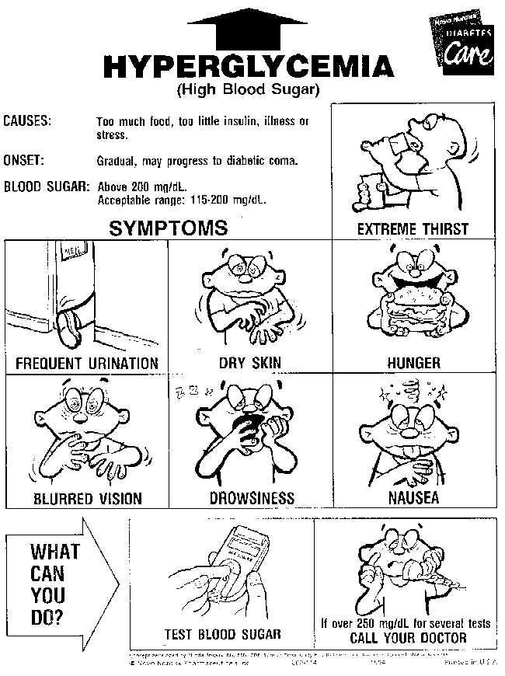

Slide 17
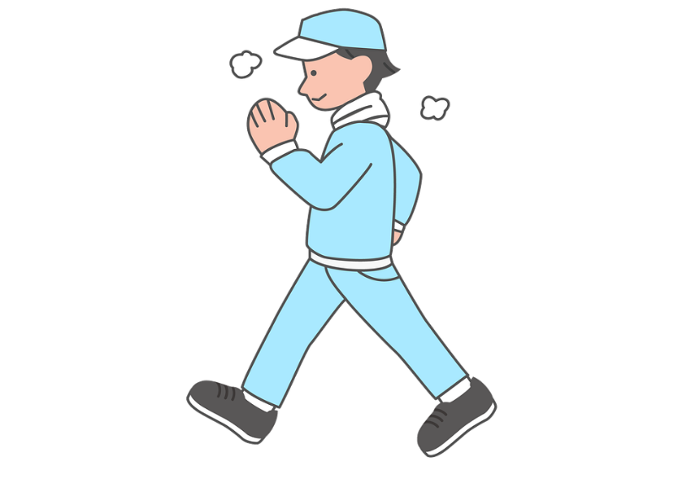
Routine monitoring of blood sugars, and consistency in following your treatment plan are keys to optimum diabetes management!
This Photo by Unknown Author is licensed under CC BY-SA-NC

Slide 18
3 Takeaway Points
1. How the pancreas is the problem in diabetes.
2. How high blood glucoses or blood sugar effects your body.
3. The main two types of diabetes.

