Slide 1

Diabetes Self-Care
AADE 7 Self-Care Behaviors
Presented by Katie Spear MSN, RN,CDCES

Slide 2

3 Take away Points
You have to learn how to take care of yourself.
Get all of the information that you can to help you stay healthy.
Make the time for your self-care.

Slide 3

AADE7
Self-Care
Behaviors
    Healthy Eating
    Being Active
    Monitoring Blood Sugars
    Taking medication
    Problem solving
    Reducing Risks
    Healthy Coping

Slide 4
AADE7 Self-Care Behaviors®
Diabetes is a complex and serious disease, and managing it every day can be challenging. To help you, diabetes care and education specialists have developed seven key areas to focus on. A diabetes care and education specialist can help you set priorities and coach you on each of these areas.

Slide 5
Healthy Eating
Healthy Eating is one of the self-management behaviors for people with diabetes, prediabetes or cardiometabolic disease.
However, what is healthy eating? Eating healthy can fit all tastes and traditions while choosing a variety of nutritious foods and beverages.
Be mindful of added sugars, saturated and trans fats, sodium and alcohol.
There are 3 main types of nutrients in food:
  carbohydrates, proteins and fats. Including some portion of all 3 in each meal, helps round out a healthy plan for improving blood glucose (sugar) and lipid (fat) levels. No one eating pattern fits everyone.

Slide 6
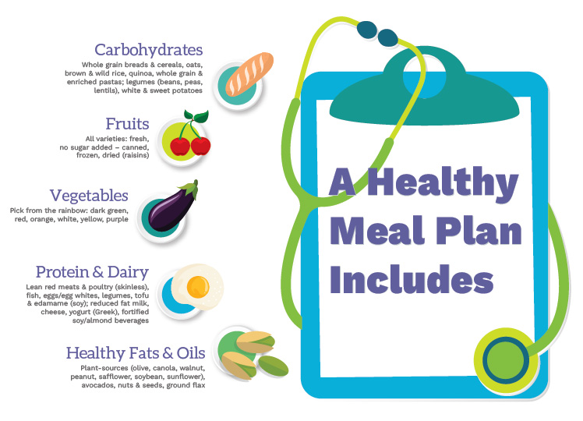

Slide 7
Healthy Eating
Collaborating with a diabetes care and education specialist, registered dietitian-nutritionist and others on your healthcare team to formulate a plan that fits your personal preferences and health needs can assist you to:
Set realistic, achievable healthy eating goals
Consider different healthy eating options
Develop a meal plan that fits you
Learn about appropriate portions/serving sizes
Understand the Nutrition Facts Label to make healthy choices
Know your carbohydrate foods and portions to avoid blood glucose spikes or drops
Be aware of sodium and saturated/trans-fat content of foods/beverages
Adjust meal plan for physical activity, holidays and travel

Slide 8
Being Active
Being active includes all the ways you move your body and decrease the time you spend sitting. If you have diabetes, it can also help keep your blood glucose closer to ideal target levels and reduce or prevent health issues now and in the future.
Being active is an important part of staying healthy. It gets your heart rate up, uses up calories, and strengthens your muscles and bones. Best of all, being active can help you:
Lose body fat
Get more fit
Boost muscle strength and aerobic endurance
Lower blood glucose
Enhance your mood
Improve blood pressure and cholesterol
Feel less stressed or anxious
Reduce your chances of dying early
If you’re already active, great – just think about moving more all day long to rev up your metabolism. If you are inactive and out of shape now, you have the most to gain by moving even a little more. Take small steps to add more movement into your daily lifestyle. In time, you will find that you are feeling better and ready to do even more.
Any amount of physical activity is better than none at all. Making physical activity part of your daily lifestyle uses up calories even if it’s not part of a structured exercise plan; so, get creative!

Slide 9
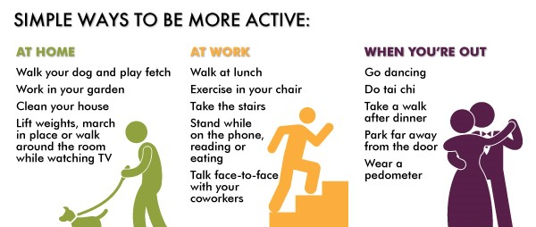
Being Active

Slide 10
Being Active
Next, start thinking about an activity plan. Focus on activities that you enjoy and can find a way to do. There are many things that get your heart rate up and burn calories. Here are a few ideas to consider:
Choose your favorite activities. Think of things YOU like to do, that way you’re more likely to keep doing them.
Take it slow. Start with five or 10 minutes of the activity and work your way up to 30 minutes at a time, five days a week (or more, if you can).
Don’t overdo it! While you exercise, you should be able to talk, but not sing.
Check your blood glucose. Do so before and after exercise to confirm what you’re doing is helping.
Keep track of your activity. This will help you feel good about yourself and progress.
Find a friend to exercise with. You can keep each other going.
Take a class. Consider checking out classes at the park district or health club, perhaps something you’ve always wanted to try, such as salsa dancing, yoga or tennis.
Join an adult league. Play a sport you enjoy, anything from basketball to badminton.
Whatever you do, make sure you mix it up. Try a few different things so you don’t get bored. If you have health issues, you should discuss with your healthcare team how they affect your ability to increase your activity level and if there are any activities you need to avoid. Your diabetes care and education specialist can help you problem solve to find what works for you.
Finding the motivation and energy to be active may be more difficult if you are having difficulty coping with the demands of your condition. Be sure to let your healthcare team know if you need more support to reach your goals.

Slide 11
Monitoring
Monitoring is an important aspect of self-care. It helps you know if you are meeting recommended treatment goals to keep you healthy.
The information you gain from regular monitoring can help you with your self-care in the following ways:
Problem solving such as learning how different foods affect your blood glucose (blood sugar), or when the optimal timing for adding activity into your day might be
Sticking with a healthy eating pattern by knowing when to have snacks and how they affect your blood glucose levels
Being able to check how your medications are working and what impact any new medications have
Being able to see overall trends that you can act on helps you maintain a positive outlook when individual numbers may be out of range
Lowering your risk of high or low blood glucose by having actionable information
Based on your goals for your diabetes, you and your diabetes care and education specialist will work together to decide what you monitor and how often. Don’t stop there. Discuss how you will use the data to make the best choices for your diabetes self-care. Your monitoring schedule should make sense for you.
How often you need to monitor your glucose depends on the type of diabetes you have, whether you take oral medication or insulin, and more. You may need to monitor only a few times a week or up to three times a day if you are using a meter. If you are wearing a continuous glucose monitor, you can see your glucose reading and the direction it's headed at any time.

Slide 12
More Than Blood Glucose
Taking care of your diabetes includes more than monitoring your blood glucose levels. It involves your overall health, such as blood pressure, weight, cholesterol levels, heart health, sleep, mood, medications, and eye, kidney and foot health.
Blood Pressure
Your blood pressure will vary throughout the day. How often and when you check it can depend on medications you are taking, timing of activity and other factors. Talk with your diabetes care and education specialist to determine the best times to check blood pressure.
Weight and Activity
Weight and activity monitoring can also provide you a more complete picture of how you are progressing toward your self-care goals. By simply looking at the numbers, you can help yourself understand how your daily choices of food, your activity, and your medications are working and how they are impacting your blood glucose and blood pressure.
Sleep
Monitoring your sleep to make sure you are getting adequate amounts and good quality sleep is important for healthy coping.There are many apps available to help you evaluate your sleeping patterns if you are looking for support through technology.

Slide 13
Taking Medication
Taking medications helps lower your risk for heart attack, stroke and kidney damage by managing blood glucose, blood pressure and cholesterol levels in your body. Diabetes is a progressive disease so the longer you have diabetes, the more help you will need from medications to keep you and your heart, eyes and kidneys healthy.
Your healthcare provider helps by choosing the right medications for you, but you play the most important role. Make sure you understand your medication plan so you can take your medicines in the right way and at the right time, every day.
Keep a list of all your current medications
  Include all prescription and non-prescription medications in your list.This includes herbal remedies, vitamins and other products purchased without a prescription.
  A medication list provides valuable information for your health care team. Be sure to include the name, dose and time you take each one.

Slide 14
Making Your Meds Work for You
Keep a list of all your current medications
  Include all prescription and non-prescription medications in your list.This includes herbal remedies, vitamins and other products purchased without a prescription.
  A medication list provides valuable information for your health care team. Be sure to include the name, dose and time you take each one.
Fill your prescription
  Filling your prescription immediately after your appointment starts you on the path to better health.
  Work with your pharmacist to find affordable medication options, send refill reminders and streamline the timing of refills. If you don’t understand or forget what the medication is for, ask your pharmacist when picking them up.
Take your medication at the right time
  Create a daily routine for taking and tracking your medications.
  Find the best times to take your medications so they will work best for you. Ask your diabetes care team about the time of day, spacing between doses, pairing medication times with your daily schedule and grouping medications that may be taken together
Share your medication beliefs and concerns
  Did Taking your medicine have positive effects on your health?
  Did your medicine cause low blood glucose (hypoglycemia)?
  Are you concerned about the number of pills you must take every day?
  Is your medication plan too complicated for your lifestyle?
Talk to your diabetes care team to learn more about the skills and actions needed to better reach your health goals. These conversations may include whether the medication’s value to your heart outweighs its cost ([LINK TO] Reducing Risk); and will the expected improvement in blood glucose ([LINK TO] Monitoring) balance the potential emotional stress ([LINK TO] Healthy Coping) of taking another medication.

Slide 15
Checklist of Knowledge and Skills
Amount of medication to take, best times to take it and how often to take it
Whether you need to take it with food or on an empty stomach
How the medication works and how to monitor to see if it is effective
Any side effects to report
What to do if you experience a problem
What to do if you miss a dose of medication or are delayed in taking it
How to store the medication so it keeps its effectiveness over time

Slide 16
Problem Solving
Problem Solving is when you come up with ways to solve a problem, then try it and see if it works. When you have diabetes, you can follow your treatment plan, check your blood glucose (sugar) often and still find that you don’t always get the results you hope for. Diabetes also changes over time and you may need some new ways to manage it. Using problem-solving techniques can help.
Problem solving involves 3 steps:
Step 1 Identify the problem
What has changed or is going to change?
Some common scenarios where you need to problem solve around your food, activity, monitoring and medications are going on vacation, getting sick, eating out or playing a sport
Step 2 Find solutions
Have you misunderstood anything about your treatment plan?
Has your life situation changed?
Are there new tools, resources or medications out there to help you?
Do you need more information to come up with the right solution for your problem?
Step 3 Take Action
Which possible solutions do I want to try? Do I need help to make it work?

Slide 17
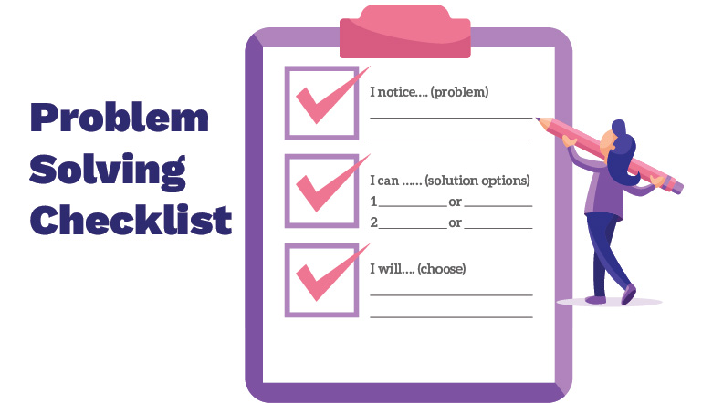

Slide 18
When you succeed in solving problems you have identified, you will gain confidence in your ability to handle future challenging situations. You can enlist the help of your diabetes care and education specialist by openly sharing your concerns and discussing your limitations in your knowledge or skills. They can guide you in setting realistic goals that can boost your ability to problem solve. You can build on your previous experiences, but also try some new things.

Slide 19
Reducing Risks
Reducing Risks means doing behaviors that minimize or prevent complications and negative outcomes of prediabetes and diabetes. Examples of these behaviors include making positive lifestyle changes, participating in a type 2 diabetes prevention or diabetes self-management education and support program, getting adequate sleep, and getting recommended vaccines and health screenings. Acknowledging that preventive actions you can take now will benefit you years from now means you have the power to change your health outcomes.
Learning about your health risks is the first step to being able to avoid complications. There are four times when it is most beneficial to meet with a diabetes care and education specialist:

Slide 20
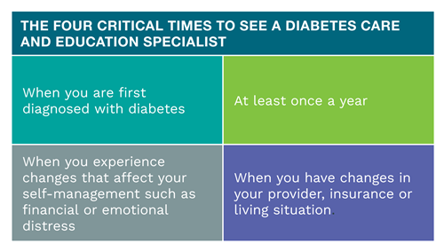

Slide 21
Recommended checks for maintaining your health
Schedule regular medical checkups. Plan to see your provider at least every three months. They can order blood tests such as an A1C which measures your average overall glucose level during the past 3 months, as well as check your blood pressure.
Get all of the recommended health checks:
  Sleep apnea screening
  Hearing loss screening
  Dental exam
  Eye exam
  Kidney function screening
  Get a cholesterol check
Take care f your feet. Look closely at the tops and bottoms of your feet every day. Look for redness, cuts, bruises or sores that won’t heal. Use a mirror if needed. Don’t go barefoot. Keep your feet clean and dry. Call your provider right away if you find a problem with your feet.
Get recommended vaccines. This includes flu, pneumonia and hepatitis B.
Don’t smoke. Smoking damages your blood vessels and increases your risk of stroke and heart attack.

Slide 22
Monitor your food, medications, exams, target levels and more. Use the data gathered to problem solve and come up with the most appropriate strategies.
Talk about your feelings. It is easy to feel overwhelmed, anxious, or depressed. Talk to your diabetes care and education specialist, healthcare provider or counselor about your feelings.These are the signs that you may need help:
  You struggle to manage your diabetes
  You avoid seeing your healthcare providers
  You have little interest or don't find pleasure in your activities
  You sleep most of the day or are not able to sleep
  You have lost your appetite or are overeating
Making sure you get recommended health checks and sticking to your treatment plan are positive steps you can take to reduce your risk of complications. Taking an active role in keeping your heart, kidneys and eyes as healthy as possible helps you achieve your desired quality of life. Act early so you can stay healthy in the long run! A diabetes care and education specialist can be a great resource for helping you understand how to reduce your risks. Ask your provider to refer you. You deserve it!

Slide 23
Healthy Coping
Successful self-management is a vital part of living with a chronic condition and emotional well-being has a big impact on your ability for self-care. There are constant demands and concerns about the future that factor into your ability to cope. Healthy coping means having a positive attitude towards managing your condition and positive relationships with others. It’s the first step on the road to reaching your health goals.
It’s important to find healthy ways to cope so you don’t turn to harmful habits such as smoking, overeating, drinking or alcohol. This is especially true if you have diabetes. Having a lot of stress can increase your blood glucose (sugar) levels, make you feel more negative and may lead to less healthy choices.

Slide 24
Healthy ways to cope with Stress
Seek support It’s important to have a network of people you can turn to. Attending diabetes education classes or a diabetes support group can help you both manage your diabetes and better cope with your feelings. Take the time to build healthy bonds that work for you and support you in your journey. Remember that you are not alone!
Move your body When you are sad or worried about something, go for a walk or bike ride. Research shows when you are active; your brain releases chemicals that make you feel better.
Think positive It may sound too simple but having a positive attitude really helps. Think about and celebrate the successes you’ve had managing diabetes (even small ones). Think about the people and activities in your life that make it enjoyable. Recalling the good stuff will help you get through the tough times.
Be good to yourself It’s important to feel good about your successes. But it’s also important not to beat yourself up if you fall short of a goal. Maybe you’re expecting too much. Maybe you’re trying to change things that are beyond your control. Do the best you can, look at what worked and what didn’t, and then move on. Do something that you enjoy every day.

Slide 25
Everyone has good days and bad days. It’s normal to feel discouraged from time to time. Sometimes, however, the stress or overwhelming feelings you’re having are a sign of something bigger. It is helpful to talk to your diabetes care and education specialist or mental health expert. Tell them about your feelings, especially if you:
Lack interest or pleasure in activities
Sleep most of the day or not able to sleep
Don’t see the value in taking care of yourself
Feel as though diabetes is defeating you or that you can’t take care of yourself
The most important thing is to realize that help is available. Your diabetes care and education specialist, your provider, and your support systems such as your family and friends are there for you. They can help you problem solve any self-care issues you are having in order to lower your stress and improve your ability to cope.

Slide 26

AADE7
Self-Care
Behaviors
    Healthy Eating
    Being Active
    Monitoring Blood Sugars
    Taking medication
    Problem solving
    Reducing Risks
    Healthy Coping

Slide 27
3 Take away Points!
You have to learn how to take care of yourself.
Get all of the information that you can to help you stay healthy.
Make the time for your self-care.

