Slide 1
Intervention and Improvement; Leveraging Feedback-Driven Assessment through Technological Innovations and Other Best Practices
Subtitle
Dan Stroud and Jarvis Hampton

Slide 2
Institutional Effectiveness
Assessment as Bureaucracy
Why do faculty distrust assessment?
Never enough time in a day, week, month, semester!
“I already know my teaching is effective.”
It’s just another tool of the accreditors and collegiate administration.
What’s the point, nobody reads this stuff anyway!!

Slide 3
Institutional Effectiveness
Improvement in Action
What’s so important about trying to improve?
“Assessing learning does not by itself result in increased student accomplishment, much like a pig never fattened up because it was weighed.”(Fulcher, et. al., pg. 3, 2014)

Slide 4
Institutional Effectiveness
Improvement in Action
What’s so important about trying to improve?
Learning becomes more meaningful.
Change, through intervention, creates positive increases in learning, year by year.
Student learning, lacking growth, becomes stagnant and mundane.
Assessment without improvement, is unreadable and underwhelming busy work.

Slide 5
Institutional Effectiveness
Improvement in Action
What are some elements of Improvement?
Your assessment needs to measure meaningful areas of necessary excellence in a given field.
Practice makes perfect.
Development of a baseline is essential – you must know where you are before deciding how much farther one has to go.

Slide 6
Institutional Effectiveness
Improvement in Action
What are some elements of Improvement?
Feedback necessitates intervention.
Intervention leads to positive change and eventual improvement.
Conversely, a lack of feedback can leave one standing in the same place … potentially minimizing paths forward.

Slide 7
Institutional Effectiveness
Feedback as Process
Feedback is a learning centric process, in which individuals must be able to comprehend given information with regard to their performance that can then be acted upon as a means to improve future efforts/results (Carless, 2015; Boud and Molloy, 2013).
A critical analysis of feedback practices in general are that such information is not geared toward an actionable end. That such information is merely cast for the purpose of justification, rather than something that could lead to intervention with the ultimate goal of improvement (Li and DeLuca, 2004; Walker, 2009).

Slide 8
Institutional Effectiveness
Feedback as a Bridge
Direct
Detailed for clarity, rather than vague and disjointed.
Actionable
Not just comments about work done, but how does it connect to future projects/tasks.
In assessment, both in process and performance, improvement is always the intentional standard.

Slide 9
Table Discussion
Does your campus routinely supply feedback on learning assessment reporting?
If so, what does that feedback look like on your campus?
Institutional Effectiveness

Slide 10

Institutional Effectiveness
The Evolution of Improvement at West Texas A&M University
Creation of Buffs Improve Feedback Form
Fillable PDF
Uniform
Easy/quick data entry

Slide 11
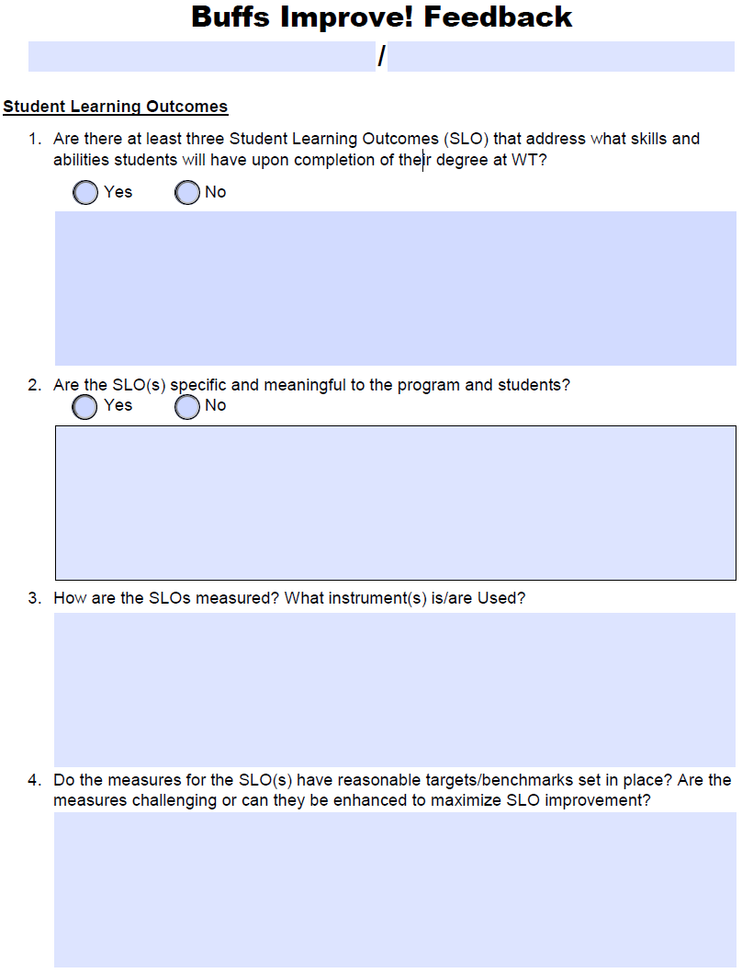
Institutional Effectiveness

Slide 12
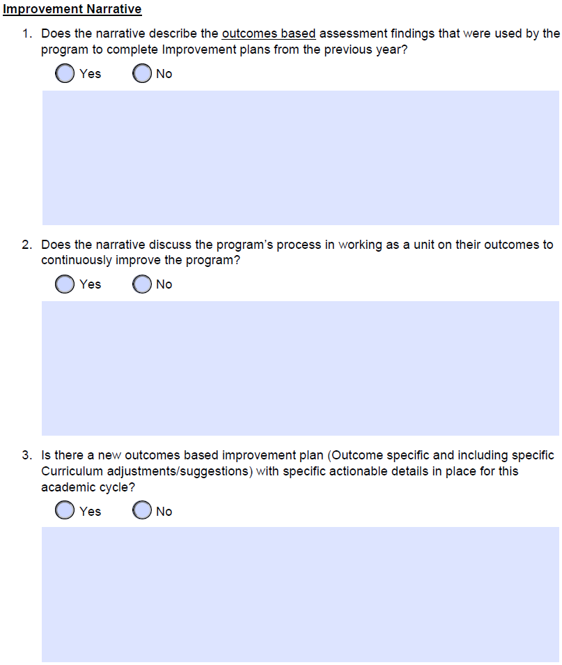
Institutional Effectiveness

Slide 13
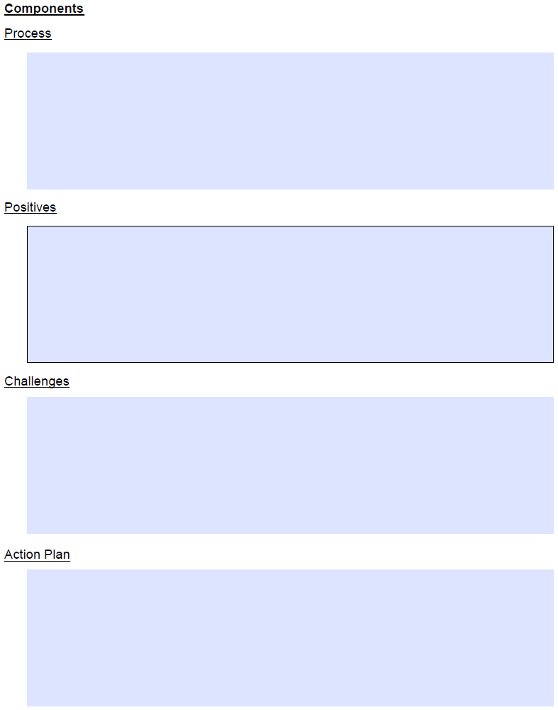
Institutional Effectiveness

Slide 14
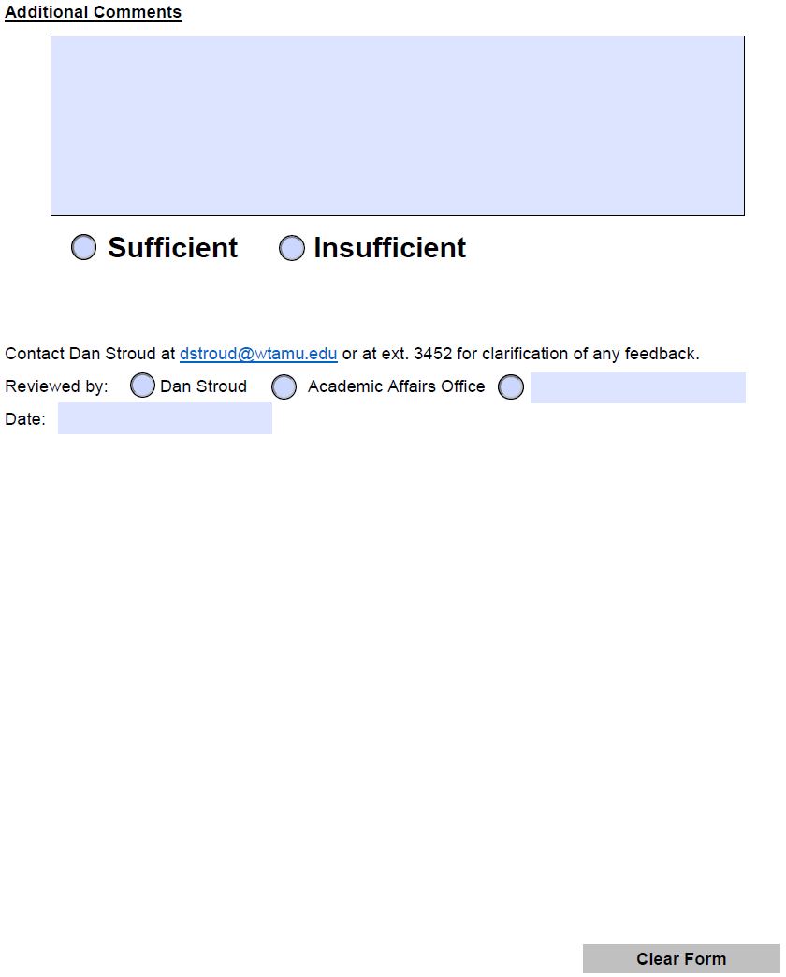
Institutional Effectiveness

Slide 15

Institutional Effectiveness
The Evolution of Improvement at West Texas A&M University
Improvement of Buffs Improve Feedback Form
Via Qualtrics

Slide 16
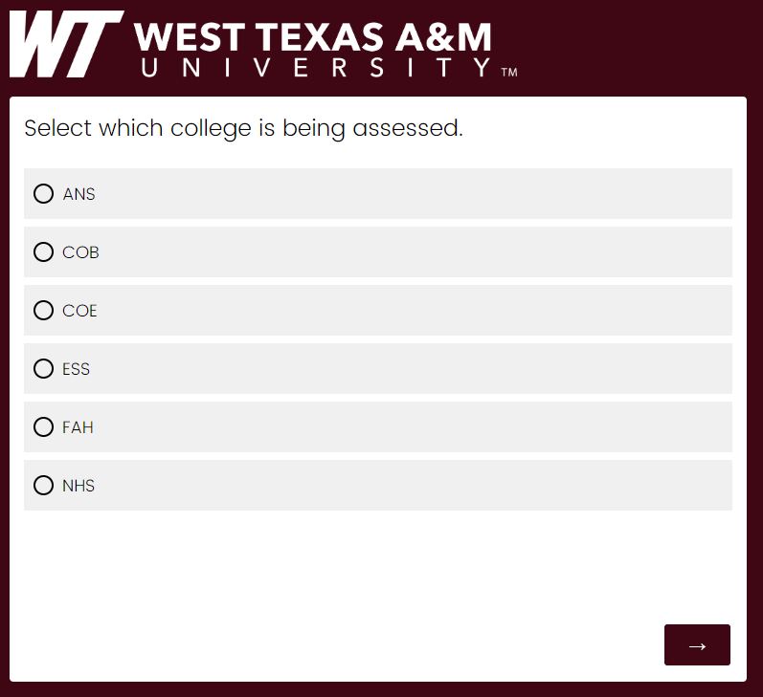
Institutional Effectiveness

Slide 17
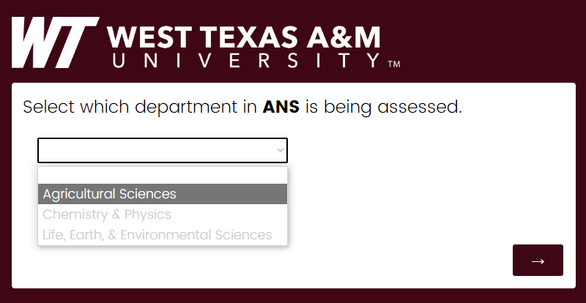
Institutional Effectiveness

Slide 18
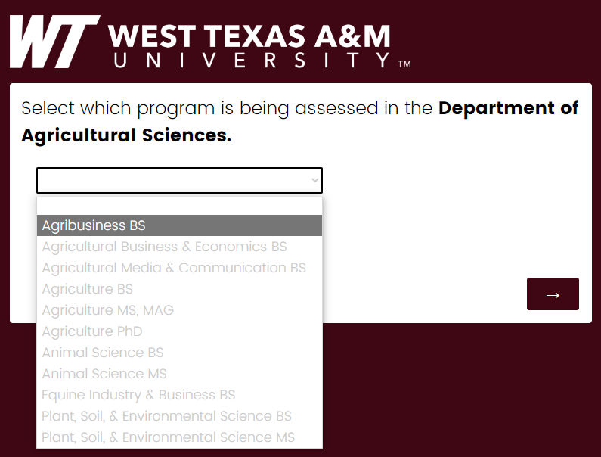
Institutional Effectiveness

Slide 19
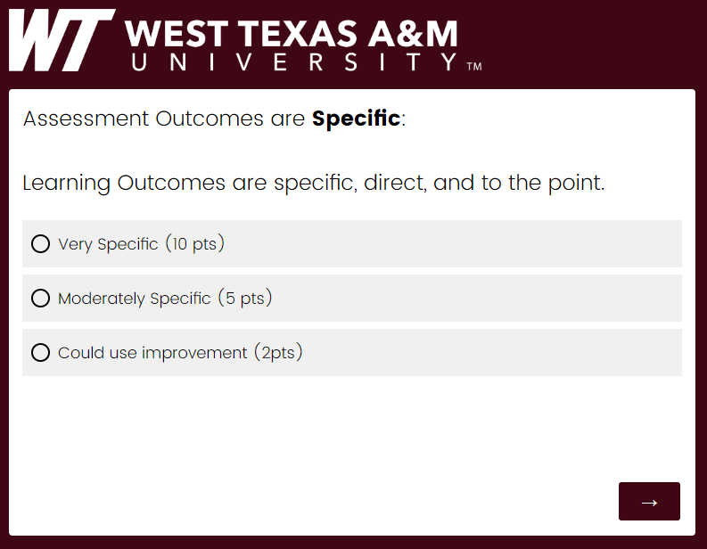
Institutional Effectiveness

Slide 20
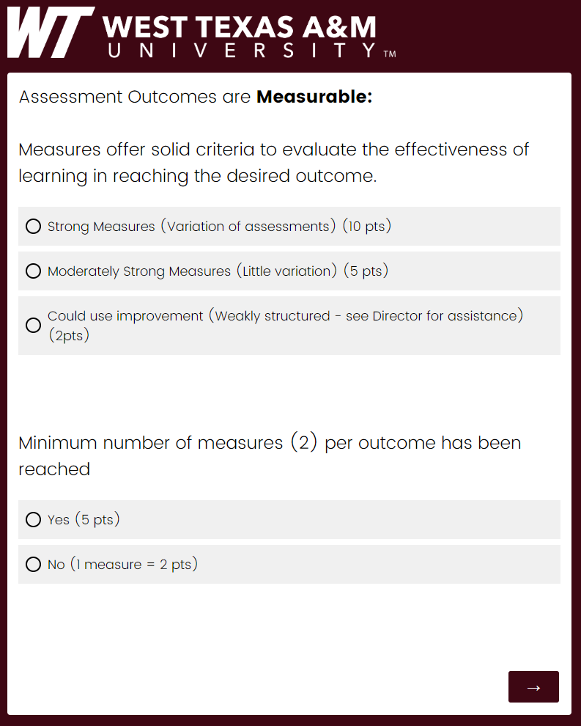
Institutional Effectiveness

Slide 21
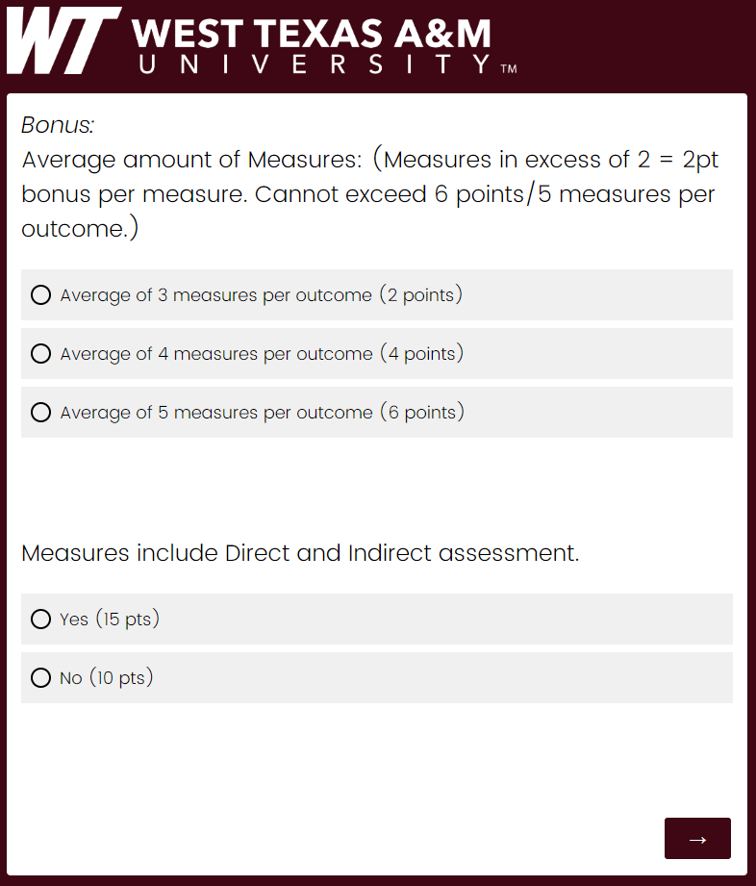
Institutional Effectiveness

Slide 22
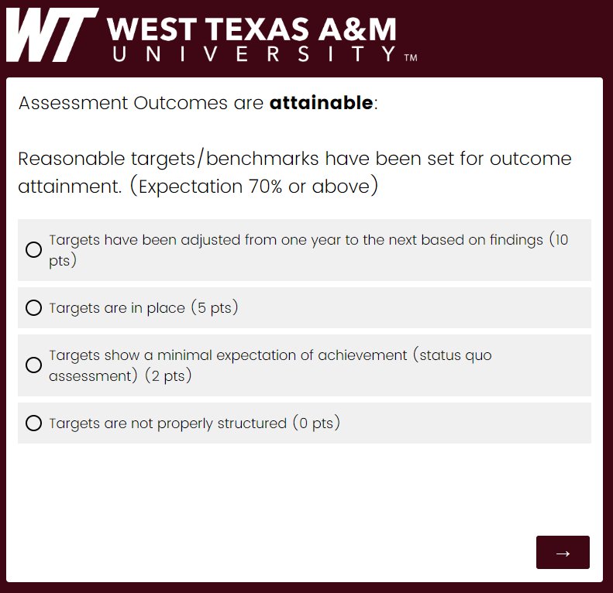
Institutional Effectiveness

Slide 23
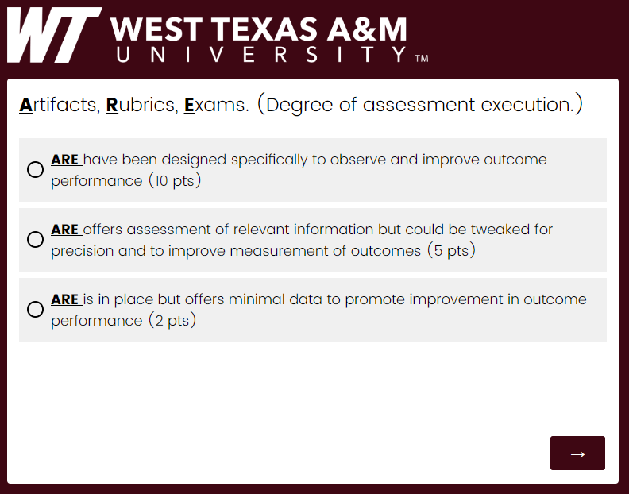
Institutional Effectiveness

Slide 24
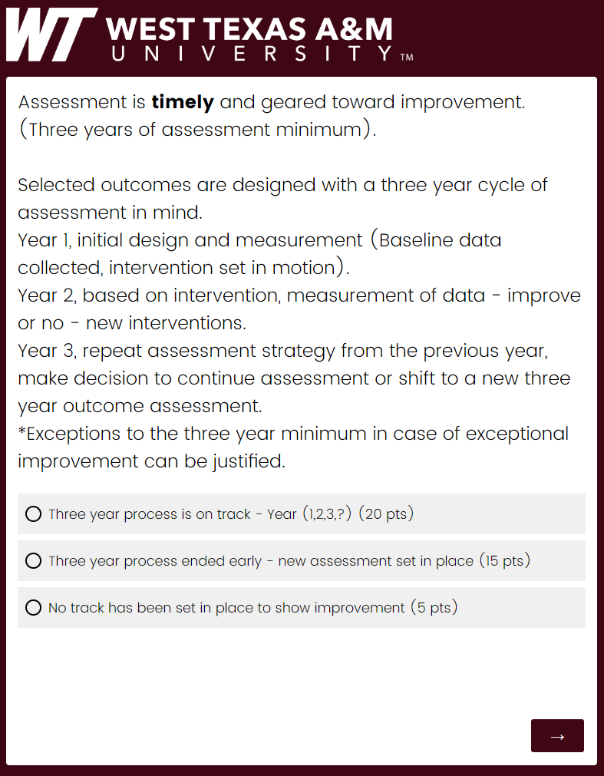
Institutional Effectiveness

Slide 25
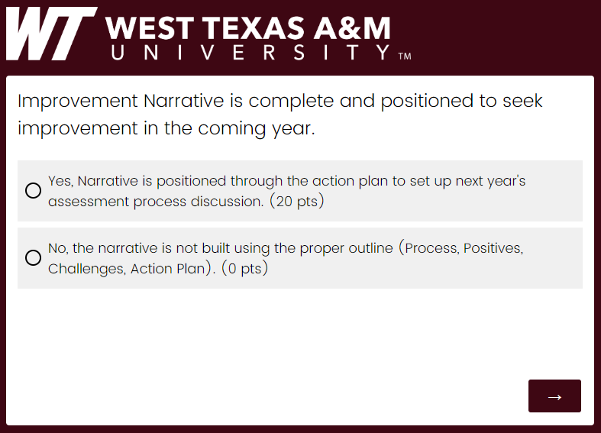
Institutional Effectiveness

Slide 26
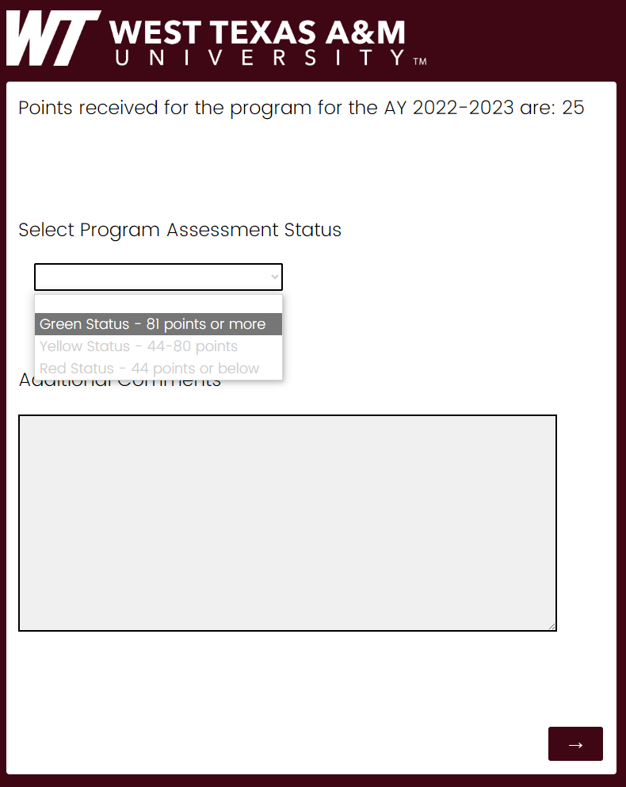
Institutional Effectiveness

Slide 27
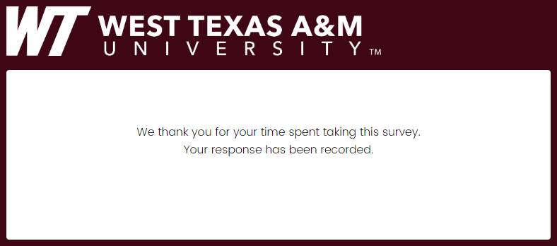
Institutional Effectiveness

Slide 28
Institutional Effectiveness
The Evolution of Improvement at West Texas A&M University
Improvement Database,
Comma Separated Values,
Dashboard
Solution =
https://analytics.wtamu.edu/improvement/index.html

Slide 29
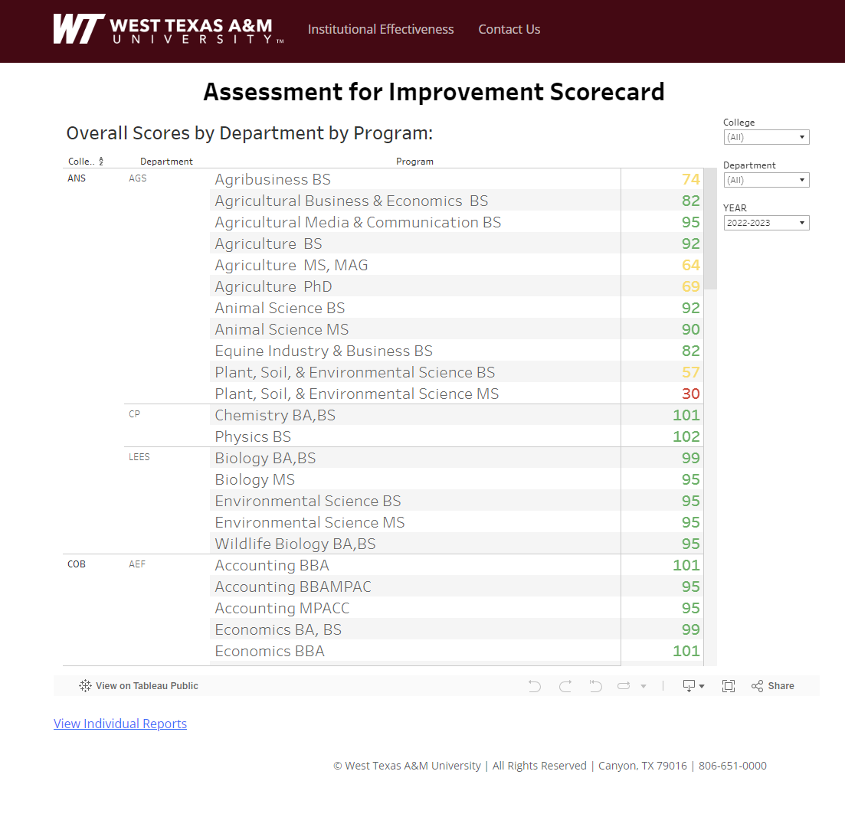
Institutional Effectiveness
The Evolution of Improvement at West Texas A&M University

Slide 30
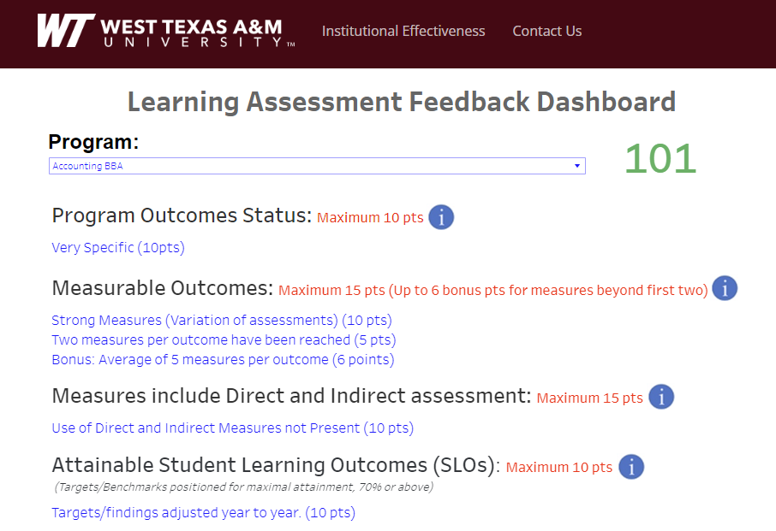
Institutional Effectiveness
The Evolution of Improvement at West Texas A&M University

Slide 31
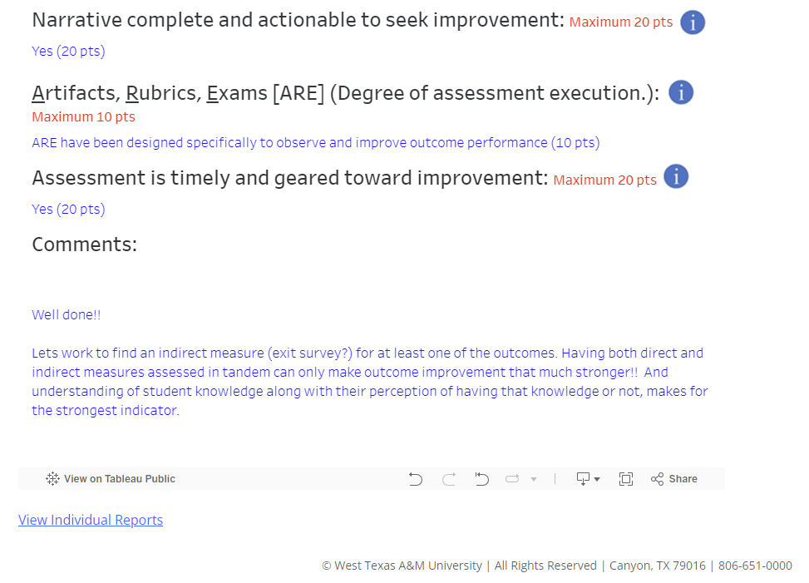
Institutional Effectiveness
The Evolution of Improvement at West Texas A&M University

Slide 32
Institutional Effectiveness
References
Boud D, Molloy E (2013) Rethinking models of feedback for learning: The challenge of design. Assessment & Evaluation in Higher Education 38(6): 698–712.
Carless D (2015) Excellence in University Assessment: Learning from Award-Winning Practice. London: Routledge.
Fulcher, K. H., Good, M. R., Coleman, C. M., & Smith, K. L. (2014, December). A simple model for learning improvement: Weigh pig, feed pig, weigh pig. (Occasional Paper No. 23). Urbana, Il: University of Illinois and Indiana University, National Institute for Learning Outcomes Assessment (NILOA).
Li J, De Luca R (2014) Review of assessment feedback. Studies in Higher Education 39(2): 378–93.
Suskie, L. (2018). Assessing Student Learning; A Common Sense Guide. (3rd Edition). Jossey-Bass Publishers.
Walker M (2009) An Investigation into written comments on assignments: Do students find them usable? Assessment & Evaluation in Higher Education 34(1): 67–78.

Slide 33
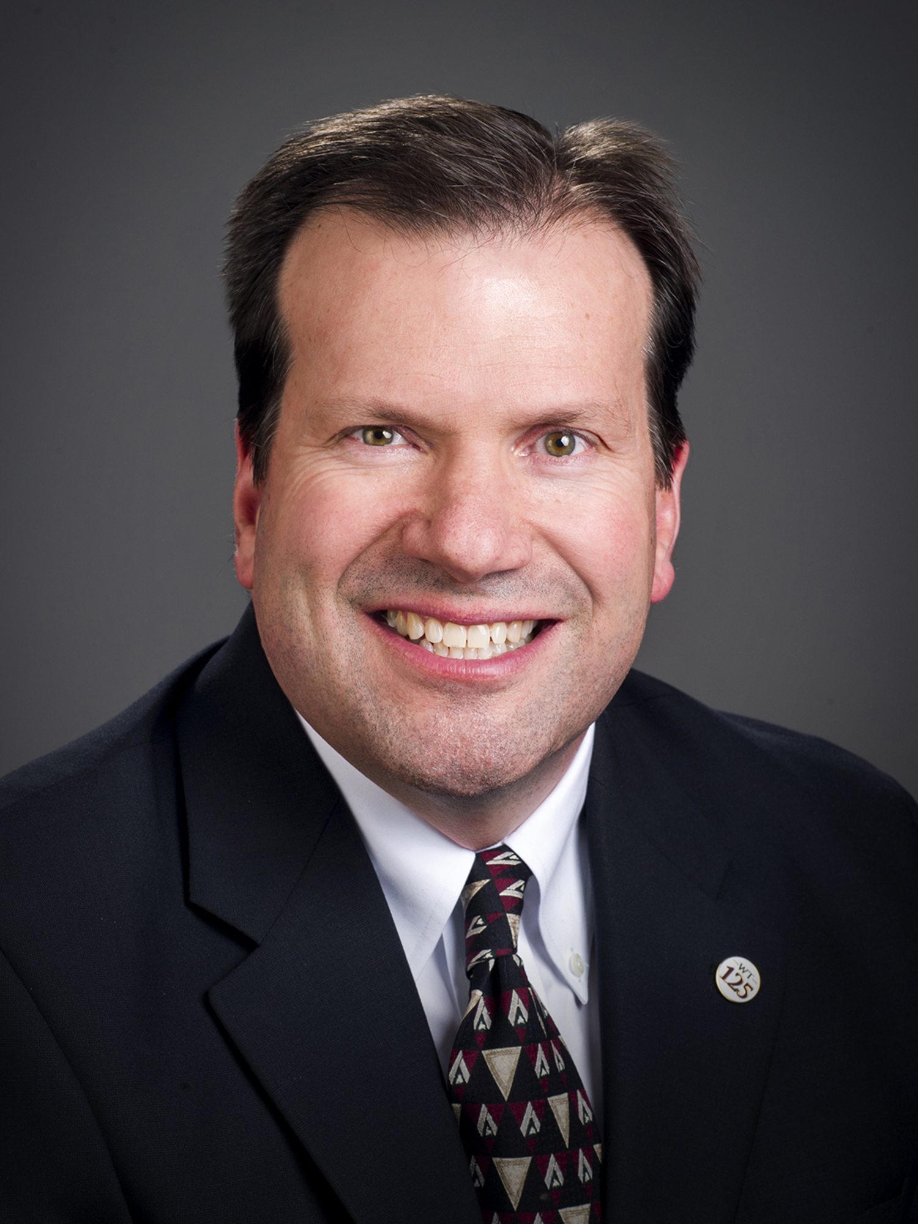

Institutional Effectiveness
Contact Us
Mr. Jarvis Hampton
Assistant Vice President of Institutional Research & Effectiveness
jhampton@wtamu.edu
Dr. Dan Stroud
Director of Assessment
dstroud@wtamu.edu

